Slide 1
Enhancing noncognitive skills to boost academic achievement
Educational Testing in America:
State Assessments, Achievement Gaps, National Policy and Innovations
Session III: Innovations in Testing
Patrick C. Kyllonen
Educational Testing Service
Princeton, NJ
Kyllonen, P.C. (September, 2008). Enhancing noncognitive skills to boost academic achievement. In Educational Testing in America: State Assessments, Achievement Gaps, National Policy and Innovations (Session III: Innovations in Testing). Willard Hotel, Washington, DC.

Slide 2

Noncognitive Skills
What are they?
Are they important for achievement?
How can we measure them?
Can they be improved?
How can we improve them?

Slide 3

Noncognitive Skills
What are they?
Are they important for achievement?
How can we measure them?
Can they be improved?
How can we improve them?

Slide 4
Cognitive Skills = Knowledge,
Ability,
Intelligence,
“Smarts”
Noncognitive Skills = Personality,
“Soft Skills” Attitudes,
“Personal Skills” Values,
Beliefs

Slide 5
What Are the Noncognitive Skills?
Professionalism
Work ethic
Teamwork
Collaboration
Oral communication
Critical thinking
Agreeableness
Ethics
Self-esteem
Diversity
Leadership
Creativity
Innovation
Lifelong learning
Enthusiasm
Values
Character
Breadth
Open-mindedness
Persistence
Collegiality
Independence
Motivation
Planning
Organization
Self-efficacy
Anxiety
Self-concept
Leading
Deciding
Supporting
Cooperating
Interacting
Presenting
Adapting
Coping
Enterprising
Performing
Extroversion
Emotional stability
Conscientiousness
Openness

Slide 6
A Simplified Framework
Personality (“Noncognitive Skills”)
  Conscientiousness
    Dependability, responsibility
    Aspiration, achievement striving
    Ethics, integrity, honesty
  Emotional Stability
    Resilience (response to feedback; working under pressure)
    “Core self evaluation” (self-efficacy, locus of control)
  Openness
    Engagement, interest, enthusiasm
  Agreeableness
    Ability to work with others
  Extroversion
    Leadership
Attitudes
  Subject-specific interest/self-efficacy (e.g., math, reading, science)
  School (e.g., identification with)

Slide 7

Noncognitive Skills
What are they?
Are they important for achievement?
How can we measure them?
Can they be improved?
How can we improve them?

Slide 8
Noncognitive factors
Yes
Why do we think they are important?
  K-12 large-scale assessments
  Industry incremental validity studies
  Industry & Higher education
  interview studies

Slide 9
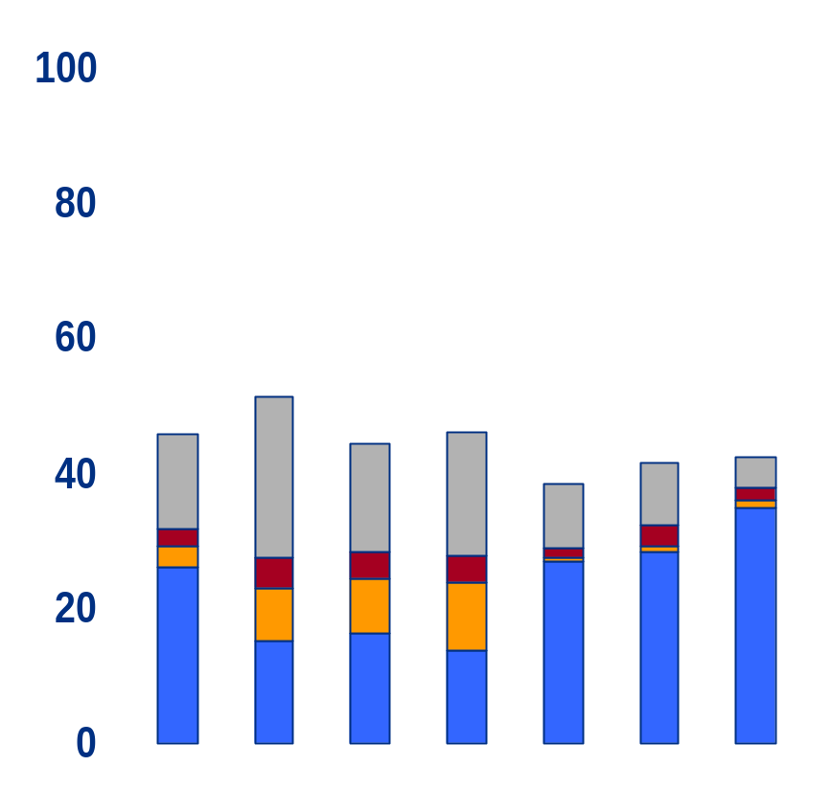
Predictive validity in K-12 Achievement tests
Source: Lee, J. (2007). Noncognitive factors in education. Paper presented at the Annual Meeting of the American Psychological Association, San Francisco, CA..
Noncognitive (personality, attitudes, values, etc.)
Home possessions (books, computer, etc.)
Multiple R
Study time (homework, absences, etc.)
Demographics (income, gender, race, etc.)
PISA Math
Note. PISA didn’t measure income or race/ethnicity (demographics), but it did measure lateness to class (study time), and student aspirations (noncognitive).
NAEP Math
ECLS Math
PISA Science
PISA Reading
ECLS Science
ECLS Reading

Slide 10
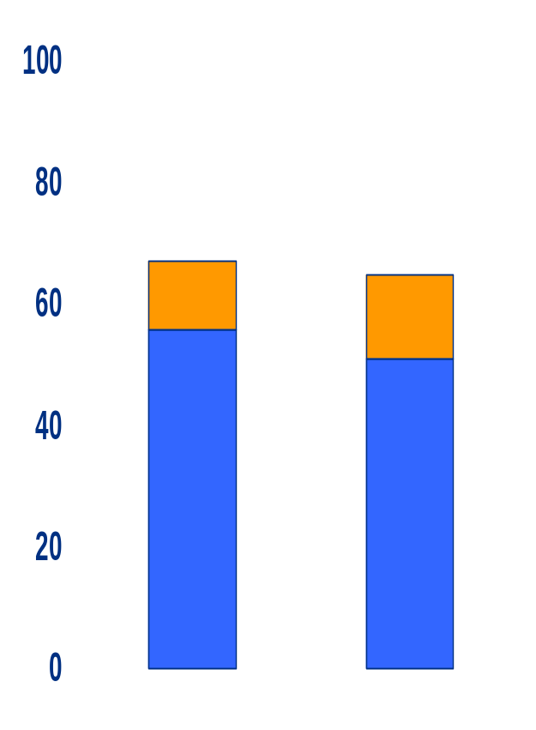
Meta-analyses have shown that noncognitive skills add to cognitive skills in predicting workforce performance
Example items:
“I arrive on time”
“I work hard”
}
noncognitive
% variance accounted for
}
cognitive
Example tests
Problem-solving
Reading
Source: Schmidt, F.L., & Hunter, J.E. (1998). The validity and utility of selection methods in personnel psychology: Practical and theoretical implications of 85 years of research findings. Psychological Bulletin. 124(2), 262-274.
Training
time
Job
performance

Slide 11
Interviews with Industry
Conference Board et al. (2006)
400+ employers interviewed
“What skills are most important for workforce?”
“How well prepared are graduates?”
“applied skills” (mostly noncognitive) ranked higher than content skills
Examples:
The Conference Board, Partnership for 21st Century Skills, Corporate Voices for Working Families, & Society for Human Resources Management (2006). Are they really ready to work? Employers perspectives on the basic knowledge and applied skills of new entrants to the 21st century U.S. workforce. New York: The Conference Board.

Slide 12

How Important are the Noncognitive Skills?
Rated “Very Important”
(Mean of HS, CC, 4-yr)
Prof./Work ethic (86%)
Teamwork/collaboration (84%)
Oral communication (83%)
Critical thinking/
problem solving (74%)
Ethics (73%)
Written communication (72%)
Information tech. (68%)
Diversity (60%)
4-yr only
Leadership (82%)
Creativity/Innovation (81%)
Lifelong learning (78%)
Writing (77%)
Reading comp (74%)
English (73%)
Math (64%)
N = 347 ~ 413

Slide 13

Noncognitive Skills
What are they?
Are they important for achievement?
How can we measure them?
Can they be improved?
How can we improve them?

Slide 14

How do we assess noncognitive skills?
Self Assessments
Teacher (and others’) Ratings
Situational Judgment Tests

Slide 15
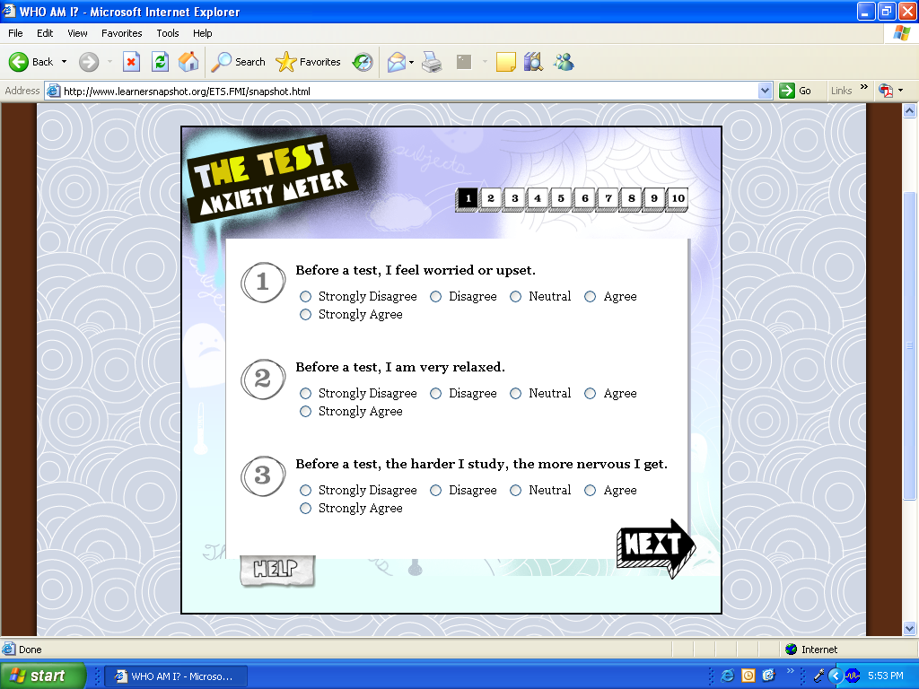
Notes:
NOTE: note that all modules have similar instructions:
– all have radial buttons that students click on to answer
all instruct students to give their first impression of whether each statement describes the way they think and feel about the situation
All modules mention that there are no right or wrong answers (very true!)

Slide 16
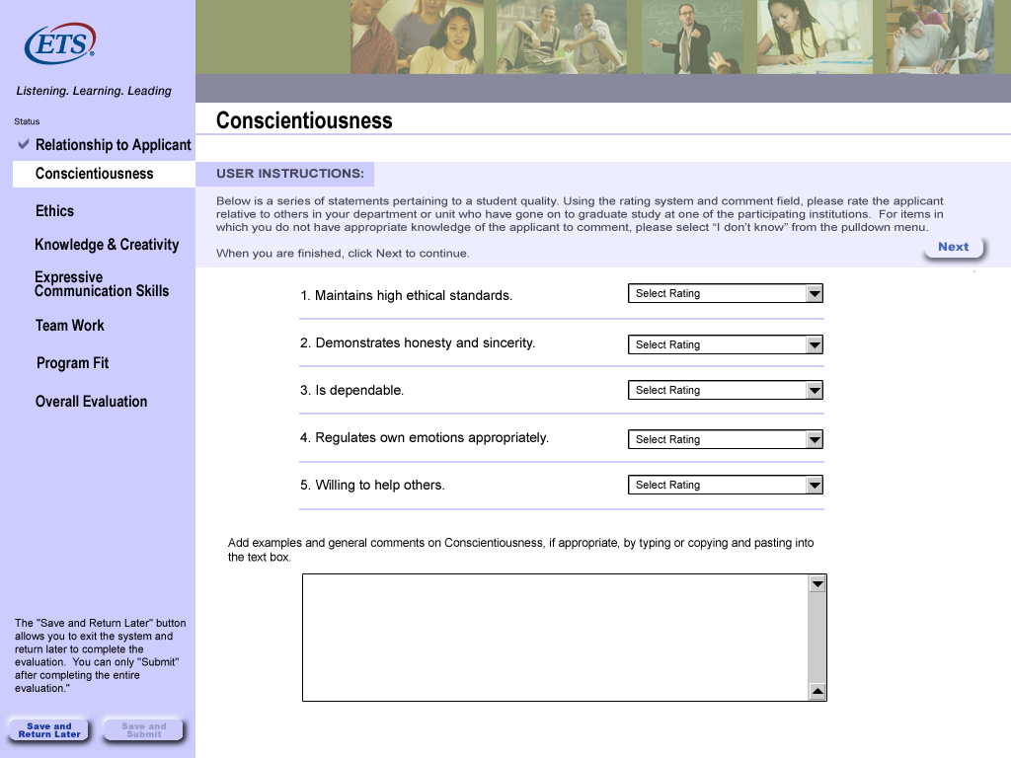
Notes:
NOTE: note that all modules have similar instructions:
– all have radial buttons that students click on to answer
all instruct students to give their first impression of whether each statement describes the way they think and feel about the situation
All modules mention that there are no right or wrong answers (very true!)

Slide 17
Situational Judgment
(Teamwork: Resolve conflict and negotiate)
You have recently formed a study group with several of your classmates in order to prepare for a difficult final exam. Unfortunately, the various members of the group have very different schedules, so you all meet after class one day to try to work out a final schedule for your group review sessions.
Which of the following is the most important factor to consider in weighing any proposed suggestions?
(A) Making sure that the schedule will allow the smartest students to attend, so that the study group will cover more material.
(B) Making sure the proposed meeting times do not conflict with your own course schedule.
(C) Yielding to the majority of the group even if it means some members will not be able to participate.
(D) Breaking the group down into sub-groups based on compatible schedules. *

Slide 18

Noncognitive Skills
What are they?
Are they important for achievement?
How can we measure them?
Can they be improved?
How can we improve them?

Slide 19
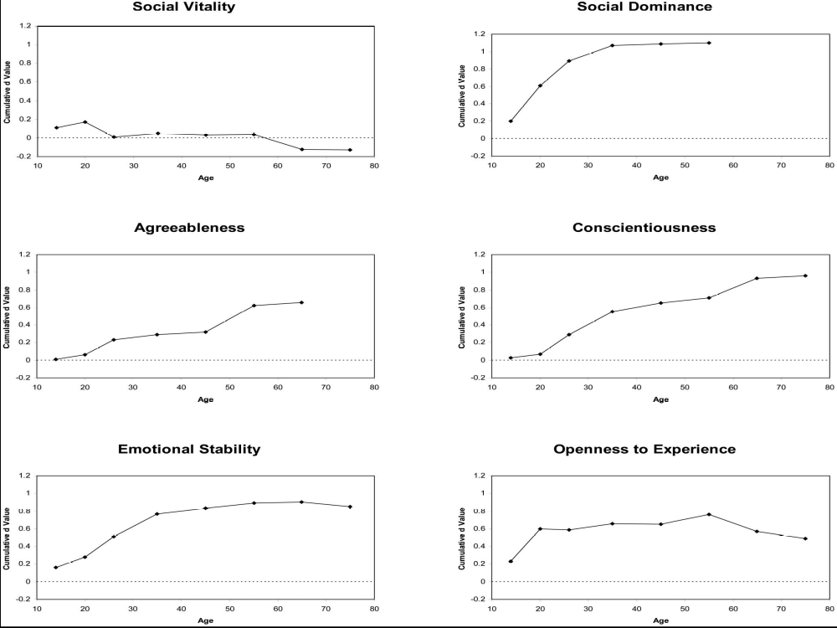

Slide 20

Noncognitive Skills
What are they?
Are they important for achievement?
How can we measure them?
Can they be improved?
How can we improve them?

Slide 21
Noncognitive Skills
What are they?
Are they important for achievement?
How can we measure them?
Can they be improved?
How can we improve them?
  Analysis of questionnaire data (to get scales)
  Expert panels to get feedback & action plans
  Randomized control trial to determine whether interventions lead to achievement (and other) gains

Slide 22
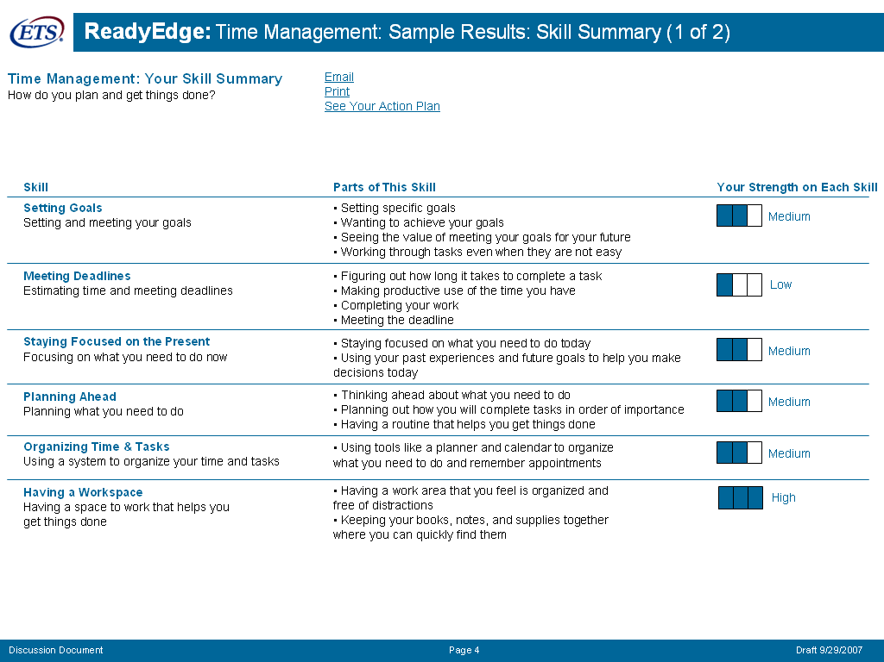

Slide 23
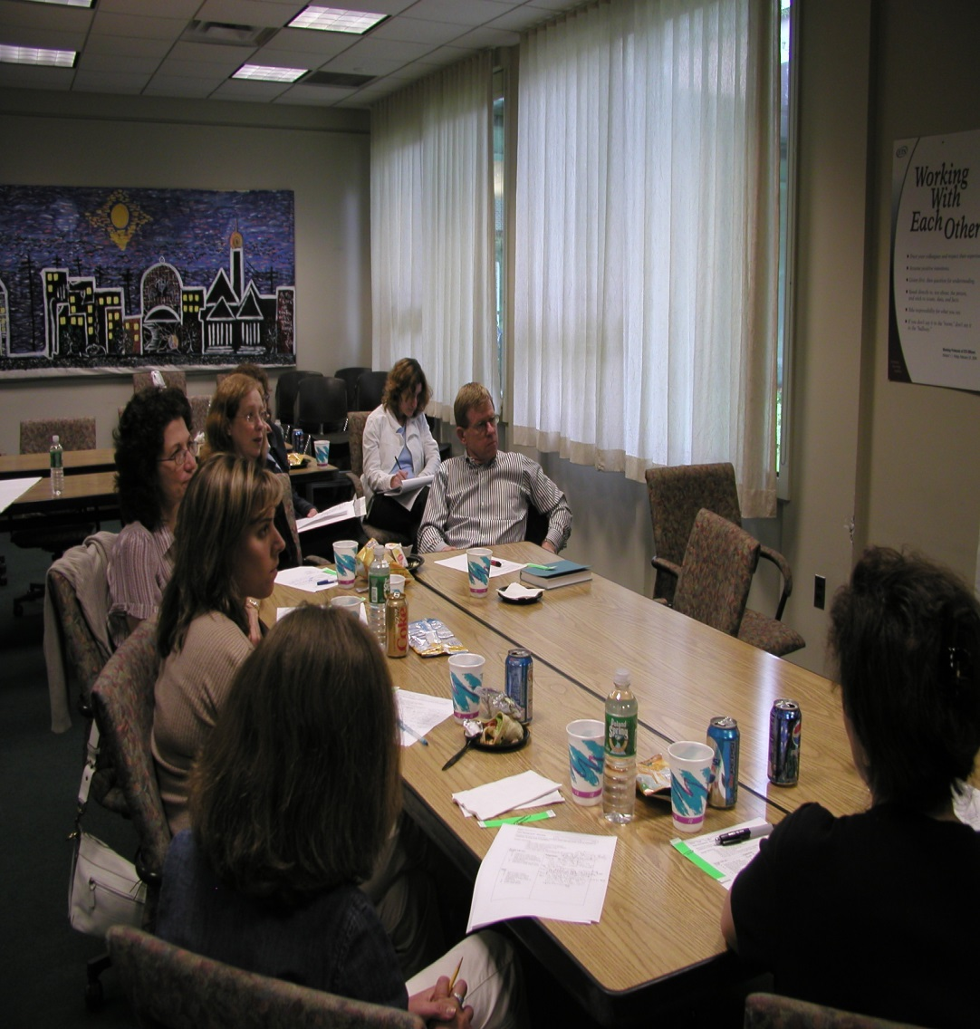
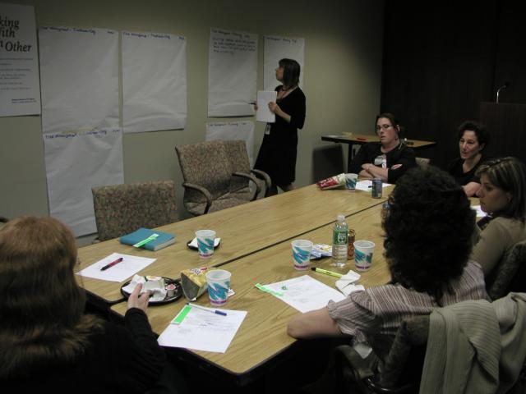
Expert Panels to Develop Feedback & Action Plans

Slide 24
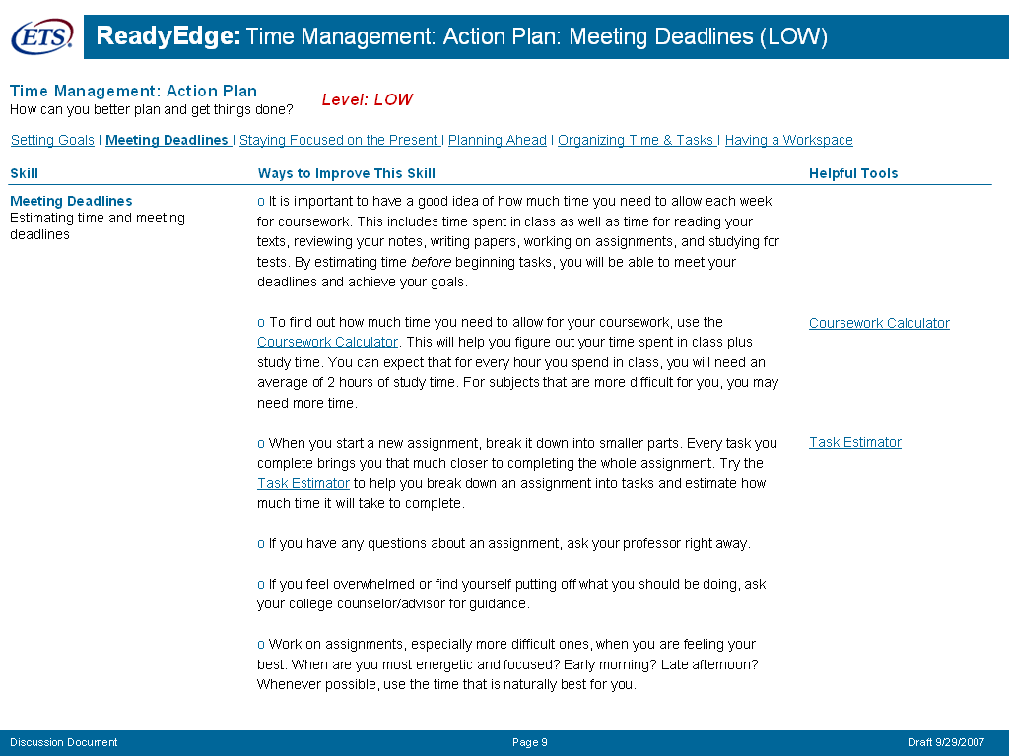

Slide 25
Summary
Noncognitive skills are important
  Educators believe
  Workforce community believes
  Validity evidence to support the belief
Noncognitive skills change over the lifespan
We are currently evaluating efforts to improve noncognitive skills (e.g., time management, test anxiety)
  & evaluate the effects of such improvements on achievement

Slide 26

Questions?
Comments?

